Slide 1
ERD - Entity Relationship Diagram
A guide by Allen Woodall

Slide 2
Types of ERD’s
Chen’s Notation
Barker’s Notation
Bachman Notation
Martin Notation

Slide 3
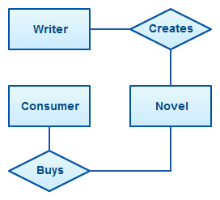

Slide 4
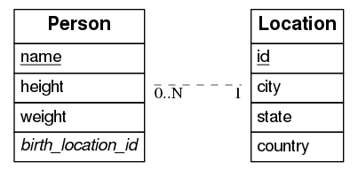

Slide 5
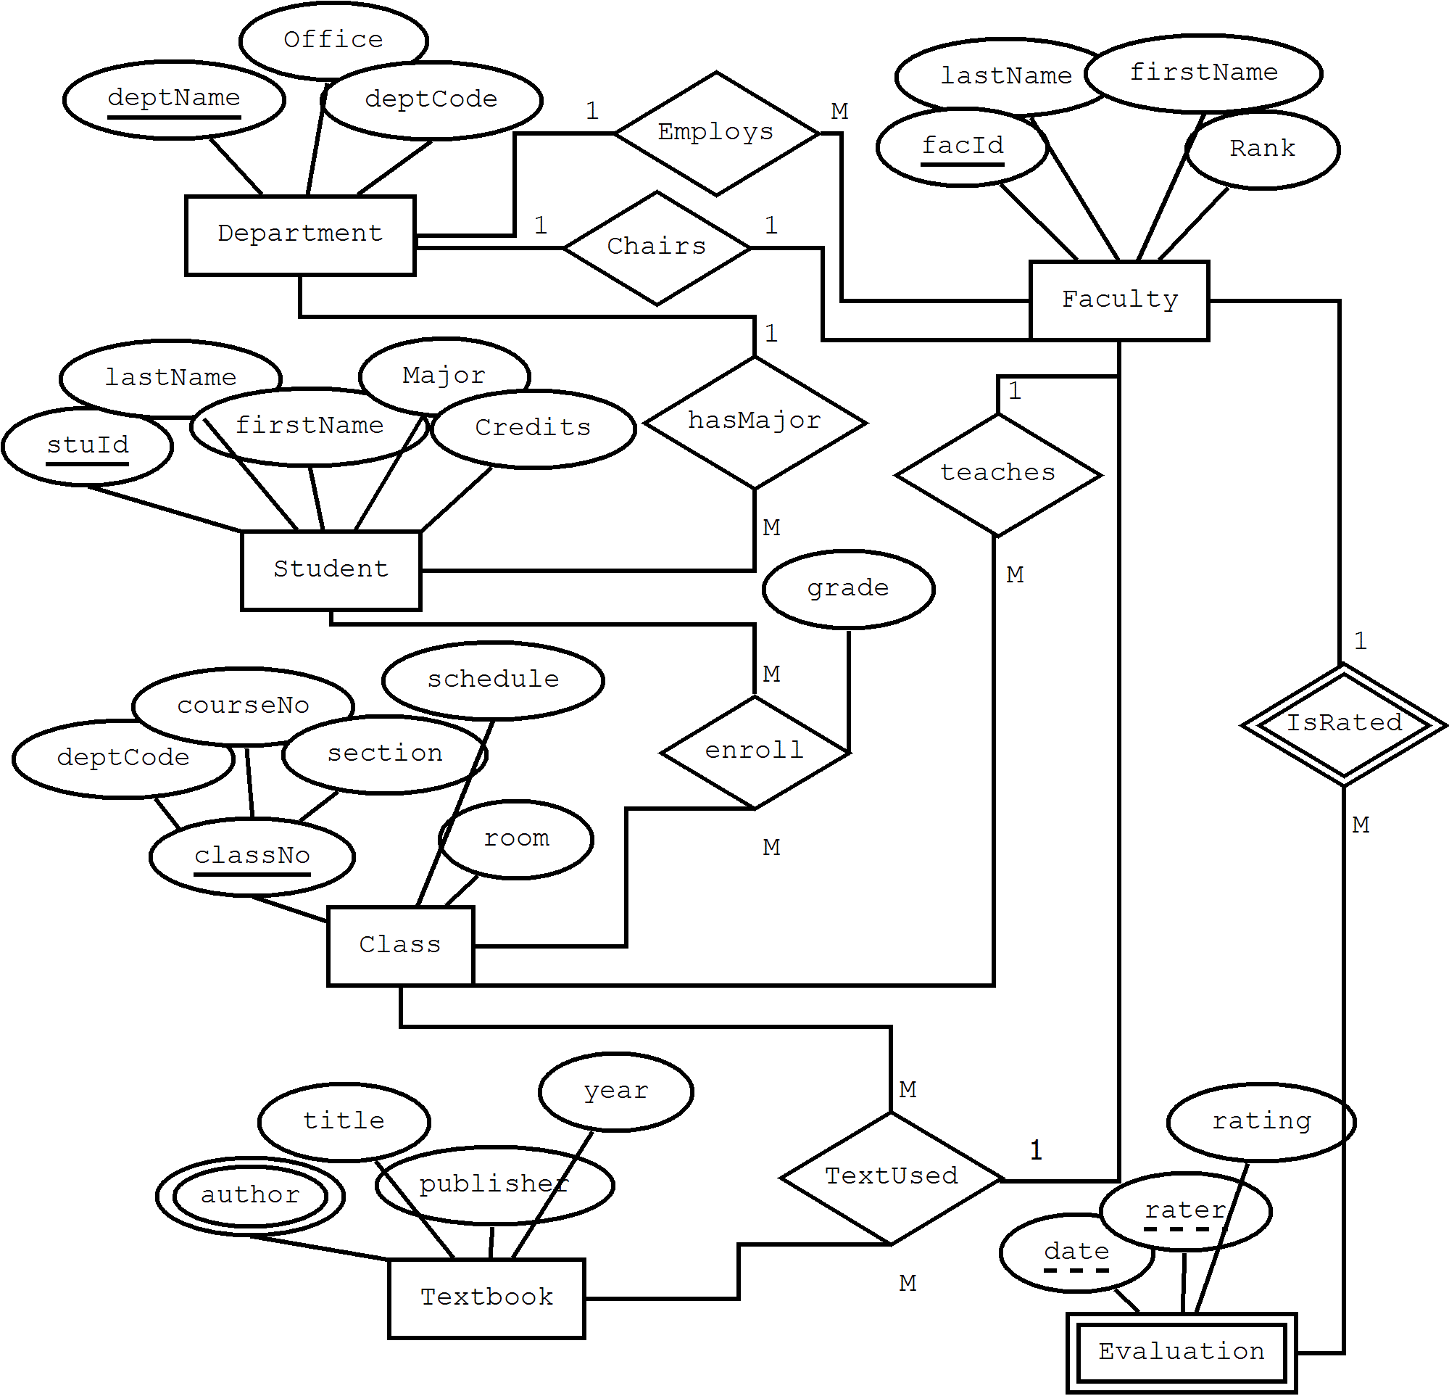

Slide 6
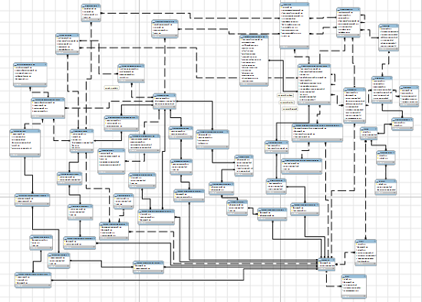

Slide 7
Why do we use ERD’s?
Model data in terms of the different types/categories and their relationships to each other
Share information on the types of data stored
Provide a model for database design
Reveal ambiguities and other data items that the system needs to store

Slide 8

Basic Steps
Identify the entities Entities are easy to recognize as they are represented by nouns.
Identify attributes These are qualities/values associated with entities
Identify the relationships between the entities Relationships are identified by verbs
Link entities to attributes and link entities together via their relationships

Slide 9
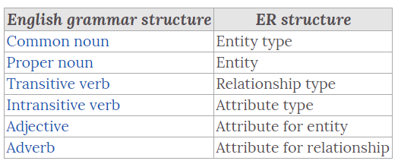

Slide 10
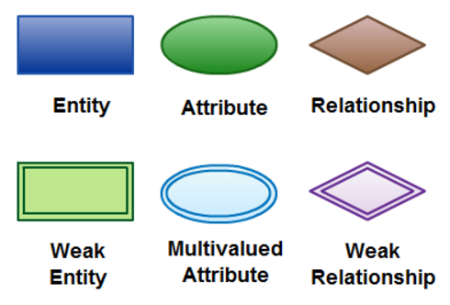

Slide 11
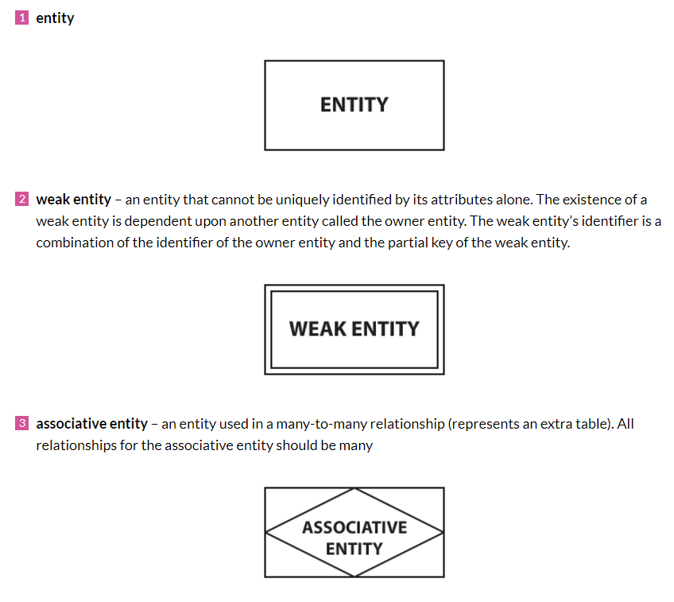

Slide 12
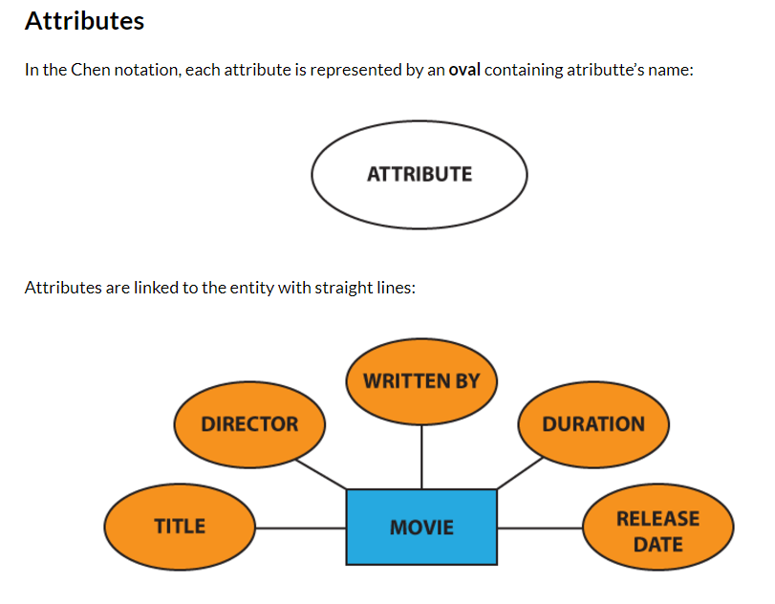

Slide 13
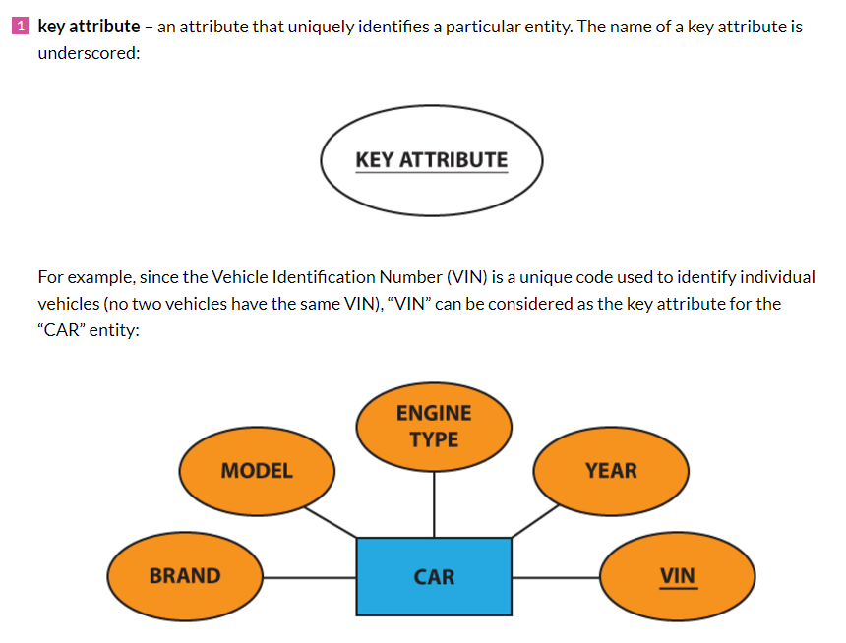

Slide 14
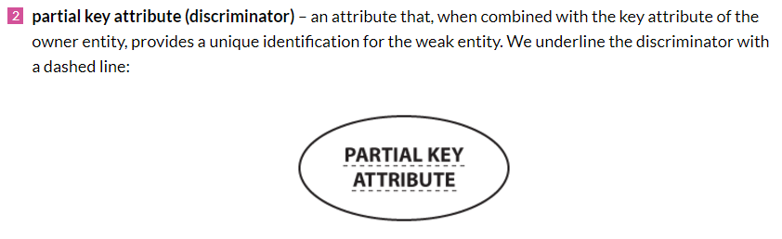

Slide 15
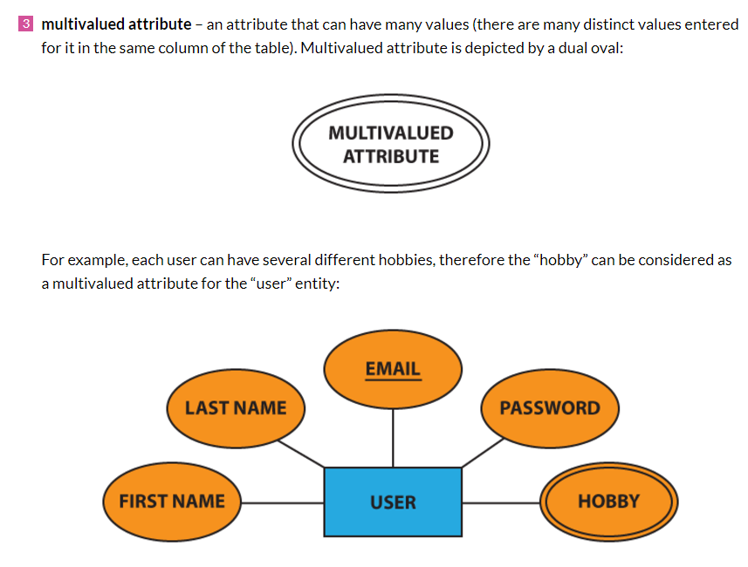

Slide 16
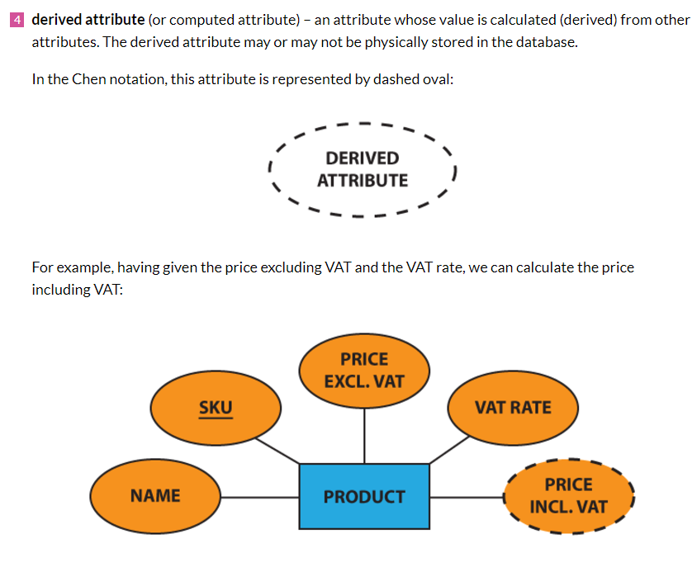

Slide 17
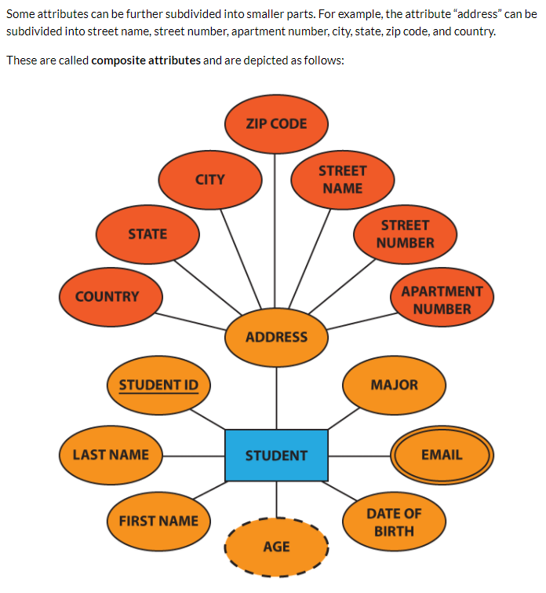

Slide 18
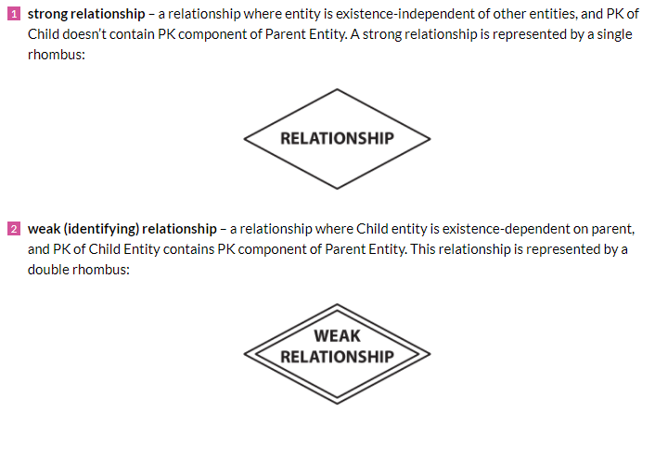

Slide 19
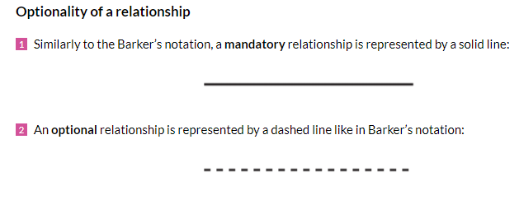

Slide 20
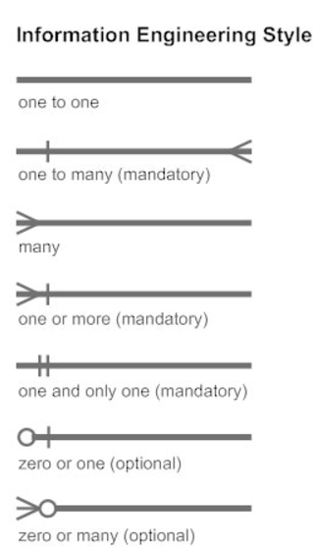
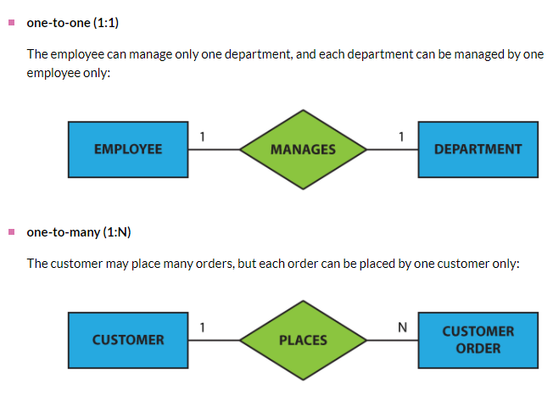
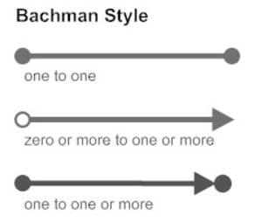

Slide 21
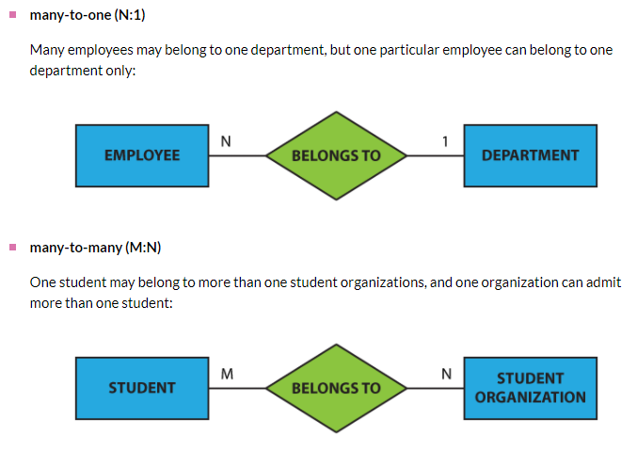

Slide 22
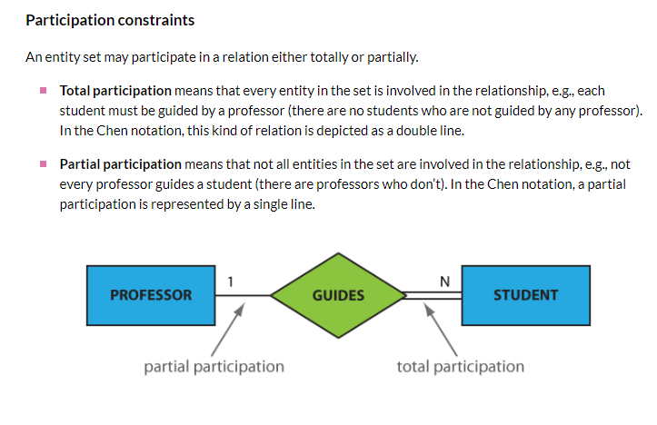

Slide 23
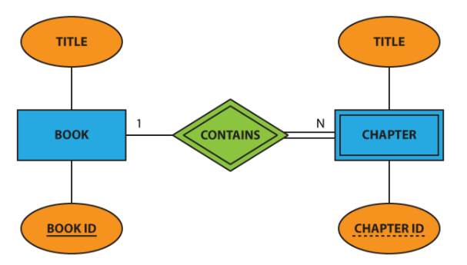
Attribute
Weak Relationship
Partial Part.
Total Part.
Entity
Weak Entity
Primary Key Attribute
Partial Key Attribute

Slide 24
